Slide 1

Comparative Analysis of Deep Learning Architectures for Multilingual and Multi-domain Automatic Speech Recognition

Slide 2
Group Member Information
Satya Lakshmi Tejaswini Gunnapaneni 700754037

Slide 3
Responsibilities and Contribution in project
Primary Contributor: sole contributor to the project, responsible for every stage from conceptualization to completion.
Project Planning: planned the project from start to finish, including setting objectives, creating timelines, and allocating resources.
Execution: performed tasks, such as research, design, development, testing, and implementation.
Problem Solving: solved any challenges encountered during the project
Documentation: prepared reports to document the project's process, outcomes, and lessons learned.

Slide 4
Motivation
Global Impact: Advancements in ASR technology can bridge language barriers, fostering inclusive global communication.
Innovation and Progress: ASR presents a frontier for technological innovation, pushing the boundaries of speech recognition capabilities.
Future Opportunities: The future of ASR promises revolutionary possibilities, from personalized virtual assistants to real-time multilingual communication tools, reshaping how we engage with the world.

Slide 5
Objectives
Research: Contribute to ASR research by exploring novel methodologies, algorithms, and techniques to expand current capabilities.
Adaptability: Develop ASR systems capable of adapting to diverse languages, dialects, and domains, ensuring robust performance across various contexts and user demographics.
Scalability: Create scalable ASR solutions adept at efficiently processing large volumes of speech data, facilitating seamless integration into a wide array of applications and platforms.

Slide 6
Related work
• Unified models for multi-lingual and multi-domain speech recognition to handle diverse linguistic contexts and domains.
• Self-supervised learning techniques to improve speech recognition performance, especially for low-resource scenarios.
• Domain robustness of speech recognition by training on diverse data covering varied acoustic conditions and domains.
• Approaches for building speech recognition for under-resourced languages with limited training data, such as transfer learning and data augmentation methods.

Slide 7
Problem Statement
The challenge of accurately transcribing speech across diverse languages and domains presents a significant obstacle in the development of robust ASR systems.
Existing ASR solutions often struggle to adapt to dynamic environments and domain-specific variations, highlighting the need for a comprehensive comparative analysis of deep learning architectures to address these limitations.

Slide 8
Proposed Solution
Enhanced Feature Extraction: Utilization of Mel-spectrogram features with optimized parameters.
Model Architectures: Exploration of CNNs, RNNs, and Transformers tailored for multi-domain and multi-lingual ASR tasks.
Dataset Utilization: Leveraging the diverse Common Voice dataset with rigorous quality control.

Slide 9
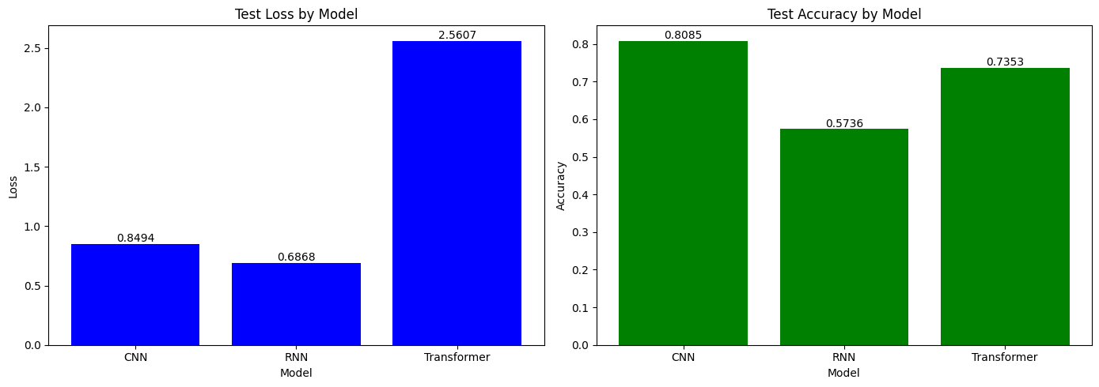
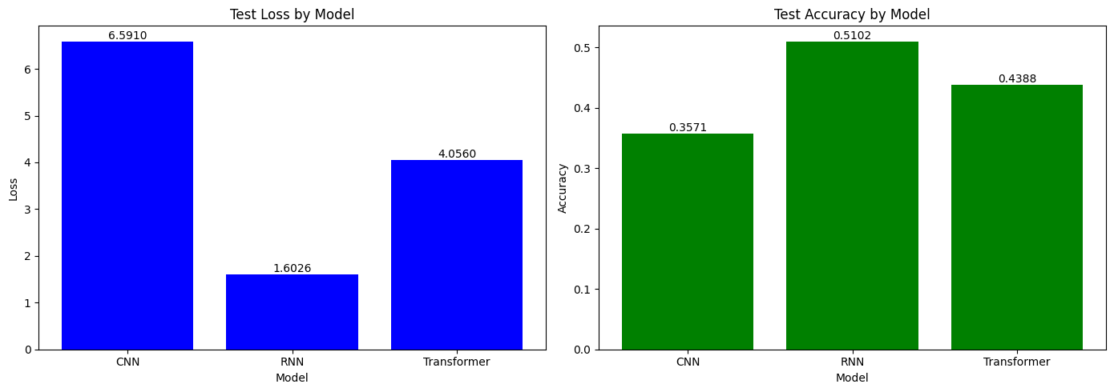
Results
language
domain

Slide 10
References
[1] Imseng et al., "Universal Multilingual Speech Model", IEEE Journal of Selected Topics in Signal Processing, 2023.
[2] Narayanan et al., "Improving Domain Robustness of Acoustic Models with Cluster Adaptive Training", Proc. IEEE ICASSP, 2021.
[3] Masakhir et al., "Cross-Lingual Transfer Learning for Low-Resource Automatic Speech Recognition", IEEE/ACM Transactions on Audio, Speech, and Language Processing, 2022.
[4] Kabore et al., "Voice Interaction in Moore Language Study on Isolated Word Recognition in Audio Samples", 2024.
[5] Feng et al., "Towards inclusive automatic speech recognition", Computer Speech & Language, vol. 84, 2024.
[6] Mallol-Ragolta and Schuller, "Coupling Sentiment and Arousal Analysis Towards an Affective Dialogue Manager", IEEE Access, 2024.
[7] Kim et al., "Empathetic Response Generation with Emotion Tracking", Proc. EMNLP, 2022.
[8] Poria et al., "Multimodal Sentiment Analysis: Addressing Key Issues and Setting Up Baselines", IEEE Access, 2017.
[9] Stan and Lőrincz, "Generating the Voice of the Interactive Virtual Assistant", Virtual Assistant, IntechOpen, 2021.
[10] Shen et al., "Transformer-Based Robust Acoustic Modeling and Adversarial Training for High-Quality Speech Synthesis", Proc. Interspeech, 2020.
[11] Polyak et al., "Speaker Encoding for Multi-speaker TTS", Proc. IEEE ICASSP, 2021.
[12] Tian et al., "A Universal Multilingual Speech Model", IEEE Journal of Selected Topics in Signal Processing, 2023.
[13] Manilow et al., "Improving Accented Speech Recognition with Multi-Task Learning", Proc. Interspeech, 2022.
[14] Potard et al., "Hierarchical Language Clustering for Acoustic Modeling in Multilingual Low-Resource ASR", IEEE/ACM Transactions on Audio, Speech, and Language Processing, 2022.
[15] Zhong et al., "Empathetic Dialogue Generation with Multiple Emotion Tracking", Proc. EMNLP, 2022.
[16] Hazarika et al., "Emotion Value Conditioning for Empathetic Response Generation", Proc. ACL, 2022.
[17] Bian et al., "MetaPerts: Few-Shot Speech Synthesis with Gradient Surgery and Meta-Learning", IEEE Journal of Selected Topics in Signal Processing, 2023.
[18] Dri et al., "Latent Neural Lyrics for Interpretable Neural Speech Synthesis", IEEE/ACM Transactions on Audio, Speech, and Language Processing, 2023.
[19] Ardila et al., "Common Voice: A Massively-Multilingual Speech Corpus", Proc. Interspeech, 2020.
[20] Gülçehre et al., "Multilingual End-to-End Speech Recognition Using CommonVoice", Proc. Interspeech, 2022.
[21] Nguyen et al., "Self-Supervised and Transfer Learning for Multilingual Speech Recognition on CommonVoice", IEEE Journal of Selected Topics in Signal Processing, 2022.
[22] Leite et al., "Self-Reported Demographics and Representation in CommonVoice Speech Corpus", Proc. Interspeech, 2022.

Slide 11
Thank you

